Slide 1
Programming in python: selection
Lesson 5: Elif

Slide 2
Objectives
In this lesson, you will learn how to:
use elif statements with if else to check multiple conditions
write a program in Python that uses an elif statement.

Slide 3
Remainder after whole number division
If we want to find out if one number is divisible by another number, we can use the remainder after whole number division operator: %
25 % 5 = 0 because 5 divides into 25 with no remainder; it is a multiple of 5.
32 % 2 = 0 because 2 divides into 32 with no remainder; it is an even number.
How can we check if a number is a multiple of 3?
num % 3 = 0
How can we check if a number is a multiple of 10?
num % 10 = 0
How can we check if a number is an odd number?
num % 2 = 1

Slide 4
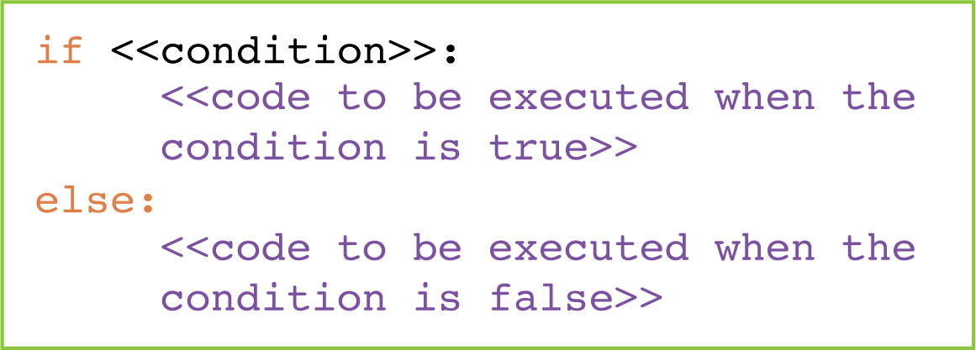
if else statements: a reminder
If-else statements are used to decide what to do if a condition is true and what to do if a condition is false:

Slide 5
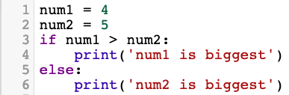

Are if else statements quite enough?
What do these programs output?
Can you spot the problem?

Slide 6

Activity 5.1: Programming in Python: selection, Section 5

Slide 7
Questions
Complete the program by filling in the gaps. It selects a random number between 1 and 10, asks the user to enter a number and compares the random number with the number entered by the user.
If the number entered by the user is bigger than the random number, the output is 'My number is smaller.'
If the number entered by the user is smaller than the random number, the output is 'My number is bigger.'
If the number is guessed correctly, the program outputs 'Well done!’.
import ____________
num = random.randint(1, 10)
guess = ______(input('What number am I thinking of? '))
if __________ > num:
print('My number is smaller.')
________ guess __ num:
print('My number is ____________')
__________
print(______________________)
random
int
guess
elif
<
bigger.
else:
'Well done!'

Slide 8
Quiz 5

